Slide 1
Records and dictionaries
Mack 2022
Notes:
Last updated: 10-31-2022

Slide 2
Make a prediction
Starter activity
1 2 3 4 5 6 7 8 | battleboard = [[".", ".", ".", "."], [".", ".", ".", "."], [".", "B", ".", "."], [".", ".", ".", "."], [".", ".", ".", "."], [".", ".", ".", "."]] print(battleboard[?][?])
Questions .
A program has been started for a battleship-style game. A battleship is represented by a B. Which indices are required to reveal the battleship?
[1][1]
[2][1]
[3][2]
[2][3]
1
▹
2
3
4

Slide 3

Lesson 1: Records and dictionaries
Objectives
In this lesson, you will:
Describe the record data structure
Use a dictionary to represent a record in a program
Use a dictionary with a list to represent records in a database

Slide 4
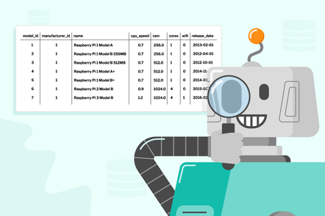
Data structure: record
Activity 1
Data structures are used to store data in an organised and accessible way. A list is a data structure.
Another example of a data structure is a record.
You might have heard of the word record if you have ever created a database before.
Notes:
Image: From a FutureLearn course from the Raspberry Pi Foundation (databases and sql)

Slide 5
Data structure: record
Activity 1
A record allows you to store a collection of attributes for a single entity.
Here is an example of a record that holds the data for a player.
player
username | "rockstar9"
password | "6goatsEating"
topscore | 5328
Entity
Attributes
Data

Slide 6
Data structure: record
Activity 1
An entity can be any object, place, person, or thing.
Attributes are properties or characteristics of that entity.
Attributes are sometimes referred to as fields.
player
username | "rockstar9"
password | "6goatsEating"
topscore | 5328
Entity
Attributes
Data

Slide 7
Data structure: record
Activity 1
A database will hold many records for a particular entity.
Question .
Can you think of any other entities that you could store in a record?
players
username | password | topscore
rockstar9 | 6goatsEating | 5328
dinomouse | 9fishDancing | 3823
sharkfish | 12ducksTweet | 4254
Possible answers .
customers, books, games, stock, cars, devices

Slide 8
Data structure: record
Activity 1
Entity
A record can be represented as pseudocode, like this example.
RECORD Player
username : String
password : String
topscore : Integer
ENDRECORD
Attributes

Slide 9
Data structure: record
Activity 1
A record is a static data structure. You must determine the attributes and the data types for each entity during declaration.
These will then be fixed for each record used in the database.
RECORD Player
username : String
password : String
topscore : Integer
ENDRECORD
Data types

Slide 10
Data structure: dictionary
Activity 1
Python does not have a native data structure for a record.
Instead, you can use a different data structure called a dictionary to represent a record.
A dictionary has some of the features of a record.

Slide 11
Data structure: dictionary
Activity 1
Here is an example of the dictionary data structure being used as a record.
Entity
Data
1 2 3 | player = {"username": "rockstar", "password": "6goatsEating", "score": 5328}
Attributes

Slide 12
Data structure: dictionary
Activity 1
Note how curly brackets are used for dictionaries in comparison with square brackets, which are used for lists.
Entity
Data
1 2 3 | player = {"username": "rockstar", "password": "6goatsEating", "score": 5328}
Attributes

Slide 13
Data structure: dictionary
Activity 1
A dictionary works differently to a list. In a list, items are accessed by their indices (their index location).
In a dictionary, you access the data using a key.
Entity
Data
🔑
1 2 3 | player = {"username": "rockstar", "password": "6goatsEating", "score": 5328}
Attributes

Slide 14
Data structure: dictionary
Activity 1
If you want to know the data associated with the username key in the players record, you use
🔑
1 2 3 4 5 | player = {"username": "rockstar", "password": "6goatsEating", "score": 5328} print(player["username"])
Question .
What will be the output for this program?
 | rockstar >>>

Slide 15
Data structure: dictionary
Activity 1
To modify the data paired with the key, you can use
1 2 3 4 5 6 7 | player = {"username": "rockstar", "password": "6goatsEating", "score": 5328} player["password"] = "7goatsEating" print(player["password"])
Question .
What will be the output for this program?
 | 7goatsEating >>>

Slide 16
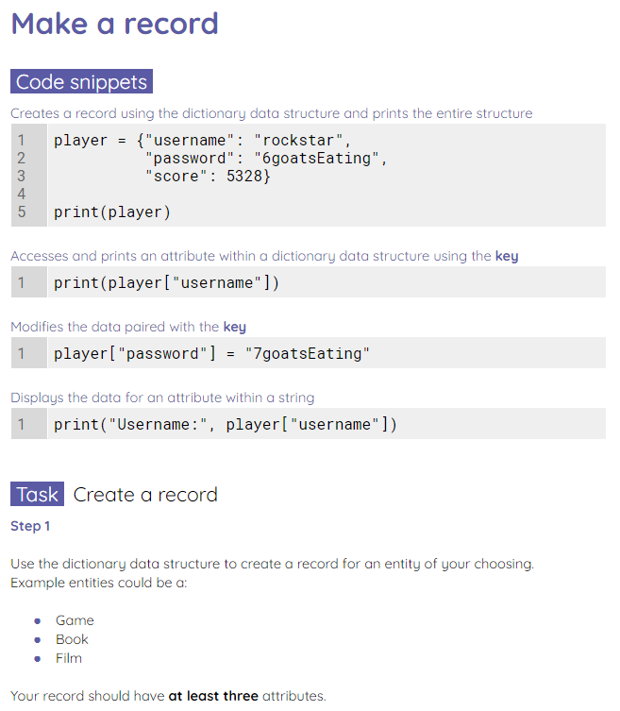
Make a record
Activity 1
Use the worksheet to create a record and practise accessing and modifying attributes.

Slide 17
Adding a dictionary to a list
Activity 2
A database can hold multiple records as seen in this example.
The database players has three records.
players
username | password | topscore
rockstar9 | 6goatsEating | 5328
dinomouse | 9fishDancing | 3823
sharkfish | 12ducksTweet | 4254

Slide 18
Adding a dictionary to a list
Activity 2
If you want to use multiple records in a database, then you can add multiple dictionaries to a list.
1 2 3 4 5 6 7 8 9 10 11 12 13 14 15 | player1 = {"username": "rockstar", "password": "6goatsEating", "score": 5328 } player2 = {"username": "dinomouse", "password": "9fishDancing", "score": 3823 } player3 = {"username": "sharkfish", "password": "12ducksTweet", "score": 4254 } players = [player1, player2, player3] print(players)

Slide 19

Adding a dictionary to a list
Activity 2
Note that each dictionary follows exactly the same fixed structure. You have just changed the data and the names for each dictionary.
1 2 3 4 5 6 7 8 9 10 11 12 13 14 15 | player1 = {"username": "rockstar", "password": "6goatsEating", "score": 5328 } player2 = {"username": "dinomouse", "password": "9fishDancing", "score": 3823 } player3 = {"username": "sharkfish", "password": "12ducksTweet", "score": 4254 } players = [player1, player2, player3] print(players)

Slide 20
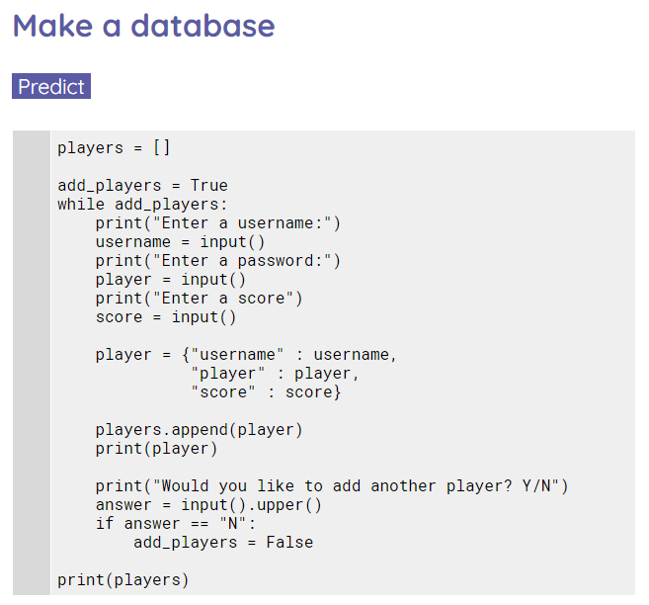
Make a database
Activity 2
Use the worksheet to make predictions about a program that builds a database using dictionaries and lists.

Slide 21
Match the keyword to the description
Plenary
Record
Used to link an attribute to a data pairing.
Entity
The properties or characteristics of an entity.
Attribute
Used to organise and store multiple records.
Database
A person, object, place, or thing that has characteristics.
Key
Allows you to store a collection of attributes for a single entity.

Slide 22
Next lesson
Summary
In this lesson, you…
Learnt how a record could be created using dictionaries in Python
Learnt how a database can be built using dictionaries and lists
Next lesson, you will…
Learn about other aspects of the dictionary data structure

